Slide 1

School of CS & AI, SR University
Course Code | Course Title | L | R | P | Cr
23CS201PC302 | Software Engineering and System Design | 2 | 0 | 2 | 3
Program Core
Lab Experiments
1. Requirements and User Stories 2. UML Modeling 3. Git Basics and Individual Workflow 4. Git Collaboration: Branching and Merging 5. Agile/Scrum Simulation 6. Implementing Design Patterns I -Creational 7. Implementing Design Patterns II -Behavioral 8. UNIT Testing with JUNIT/pytest 9. CI/CD Pipeline 10. API Interaction 11. System Design Diagramming 12. Exploring Scalability Components -Conceptual
Lab- 3 (week 3)
3. Git Basics and Individual Workflow
Prepared by
Dr. K. Rajchandar
Assistant Professor

Slide 2
Lab Objectives
Understand the role of Git in modern software development.
Learn the basic commands of Git for individual development.
Practice version control by creating repositories, committing changes, and managing versions.
Apply Git workflows that simulate real-world software engineering practices.

Slide 3
🧠 Learning Outcomes
Student Will Be Able To:
✅ Track code changes using Git
✅ Commit meaningful messages
✅ Connect local repo with GitHub
✅ Push code for backup and visibility

Slide 4
Software Engineering
🏗️ Git is Essential For:
Managing team collaboration
Applying Agile and DevOps practices
Tracking requirements and features
Ensuring quality, reproducibility, and auditability
🚀 Real-World Example: When working on a project like a mobile app, Git lets each developer contribute code without disrupting others. One can add a new login feature while another fixes a bug, all without conflict — thanks to Git's branching and merging.

Slide 5
Git Basics & Individual Workflow
Git Basics | Individual Workflow
Git tracks code changes | You’re the sole contributor
Key commands: init, commit, push, pull, merge | No merge conflicts, minimal branching needed
Repos: Local & GitHub | Used in personal portfolios, labs, or solo projects
Track project history | Helps learn Git before moving to team-based (collaborative) Git
👤 What is Individual Workflow in Git?
Individual workflow means you're working alone on a Git project without collaborating with a team.
🧩 Features of Individual Workflow:
You work independently on a single repo (typically on GitHub).
You are the only one pushing, committing, and merging changes.
Useful for personal projects, assignments, or learning Git.

Slide 6
✅ Basics of Git:
Git is a distributed version control system used to manage and track changes in code collaboratively or individually.
Concept | Description
Repository (repo) | A folder that Git tracks (local or remote).
Commit | A snapshot of your project at a particular point in time.
Branch | A separate line of development; commonly used for features or experiments.
Merge | Combines changes from one branch into another (e.g., from feature to main).
Clone | Downloading a remote repo to your local machine.
Pull | Fetching changes from the remote repository to your local one.
Push | Sending your committed changes from your local repo to a remote repo.
Status | Shows the current state of your working directory.
Diff | Shows differences between versions of files.
Log | Displays the commit history.
Init | Initializes a new Git repository.
.gitignore | A file that tells Git which files/folders to ignore.

Slide 7
Assignment 3
📚 Pre-requisites for Students:
Install Git and basic text editor (VS Code or Notepad++).
GitHub account created and accessible.
Basic understanding of command line/terminal.
🧪 Lab Setup:
Requirement | Details
Software | Git (installed locally), VS Code (optional)
Platform | GitHub (online) or GitLab
Duration | 2 hours

Slide 8
✅ What is Git?
Git is a distributed version control system used to track changes in source code during software development. It allows multiple developers to collaborate efficiently while maintaining the integrity and history of the project.
🔑 Feature | 💡 Explanation
Version Control | Git keeps track of every change made to code. You can revert to previous versions easily.
Collaboration | Multiple developers can work on the same project simultaneously without overwriting each other’s work.
Branching & Merging | Developers can create branches to work on features or fixes independently and merge them back once tested.
Backup & Recovery | Code is backed up in remote repositories like GitHub/GitLab, making it safe and recoverable.
Traceability | Every change is recorded with a message and timestamp. You can see who made what change and why.
Open Source & Widely Used | Git is free, open source, and the standard tool in the software industry.

Slide 9
🏗️ In Software Engineering, Git is Essential For:
Managing team collaboration
Applying Agile and DevOps practices
Tracking requirements and features
Ensuring quality, reproducibility, and auditability

Slide 10
🧪 Git Activity Case Study
🎯 Case Study Title: "MyPortfolio Web Page“
🧑‍🎓 Objective: Learn Git basics by creating and tracking a personal web portfolio (single HTML file) using Git and GitHub.

Slide 11
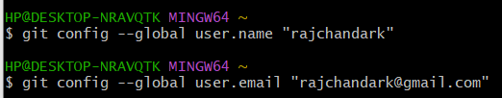
🪜 Step-by-Step Procedure (Git + GitHub)
📍STEP 1: Install Git (One-time setup)
Download Git: https://git-scm.com/downloads
Install with default settings.
📍STEP 2: Configure Git
git config --global user.name "Your Name"
git config --global user.email "you@example.com"

Slide 12
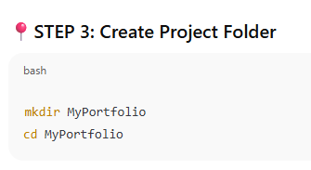

Create folder in GIT

Slide 13
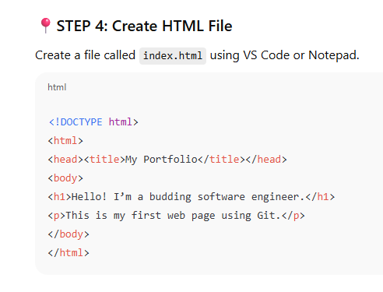
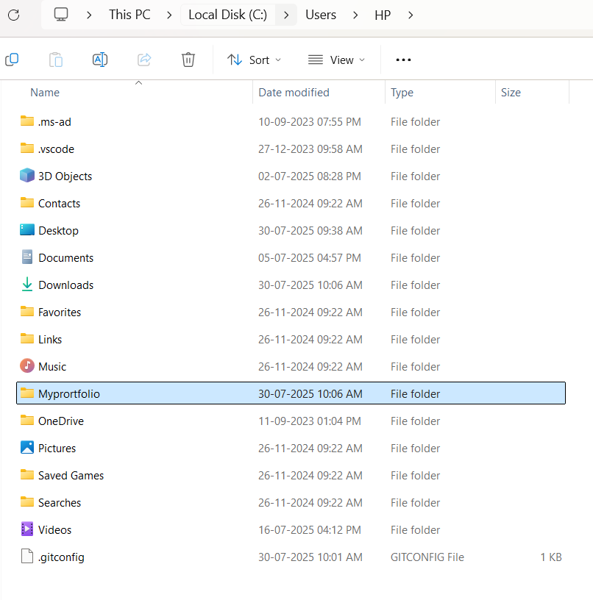
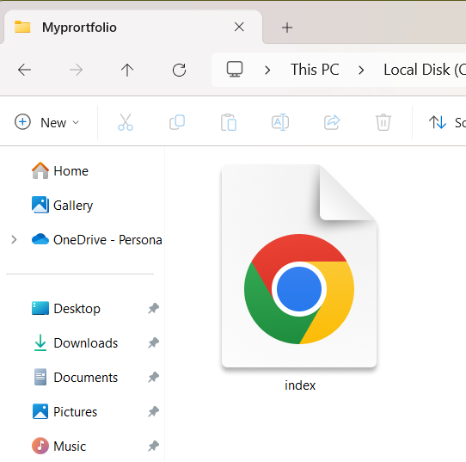
Create HTML file

Slide 14
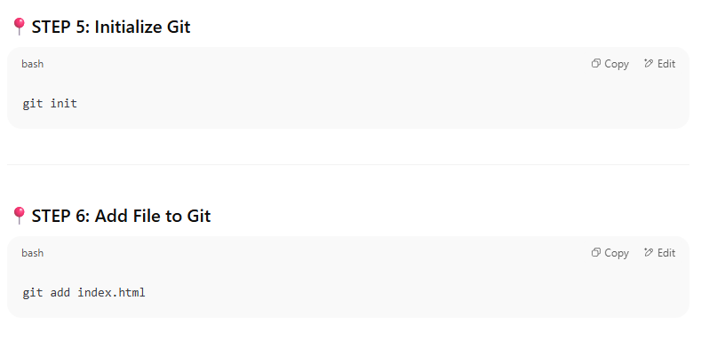


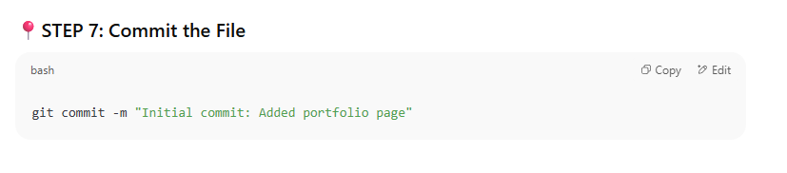

GIT – Commands

Slide 15
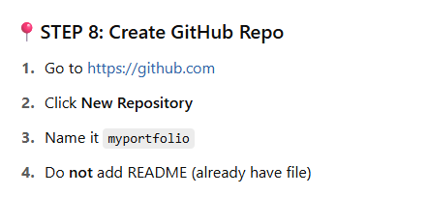
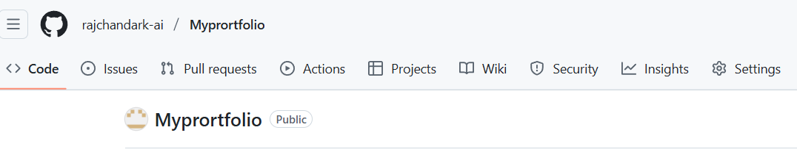
Create a Repository in GIT-HUB

Slide 16
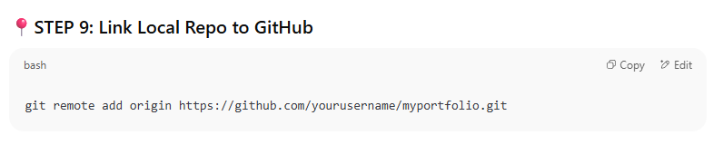
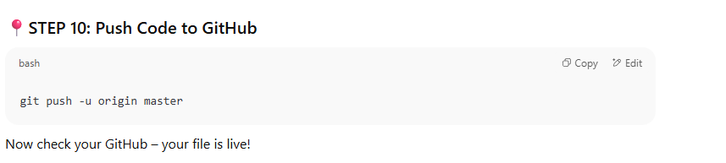
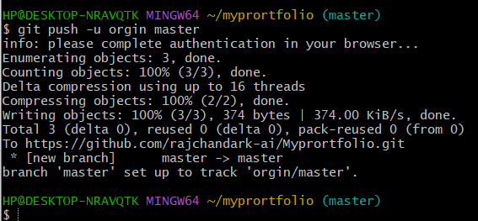
Link remote and Push code to GIT-HUB

Slide 17
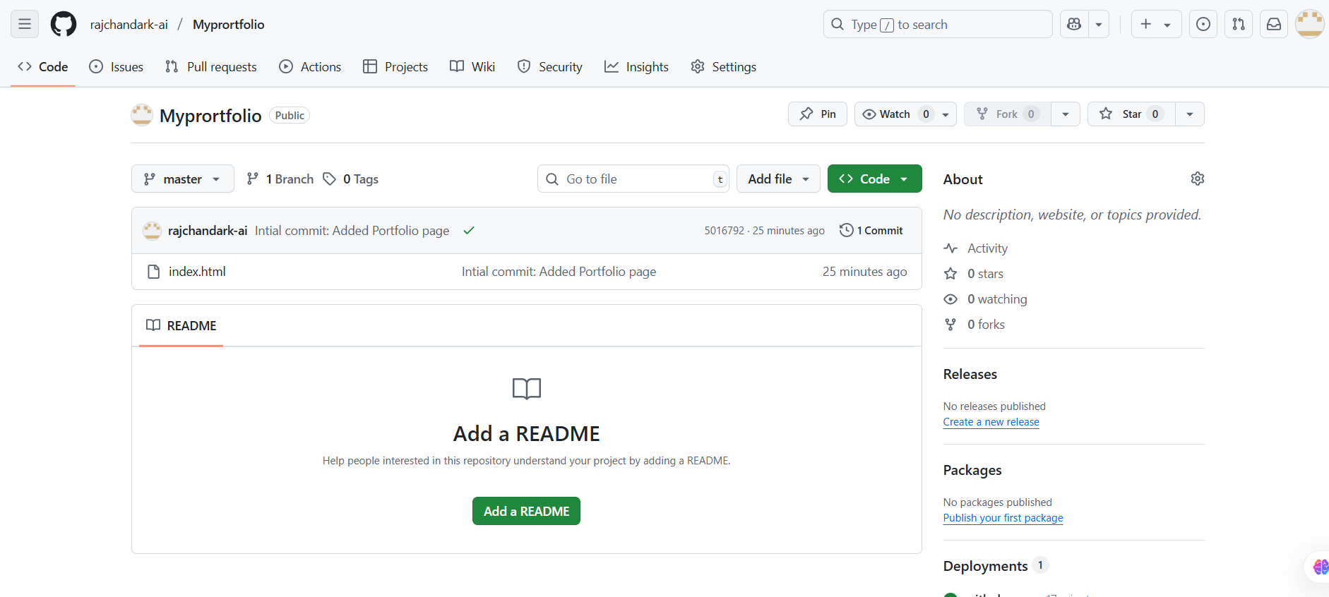
Your repository page at GIT-HUB

Slide 18
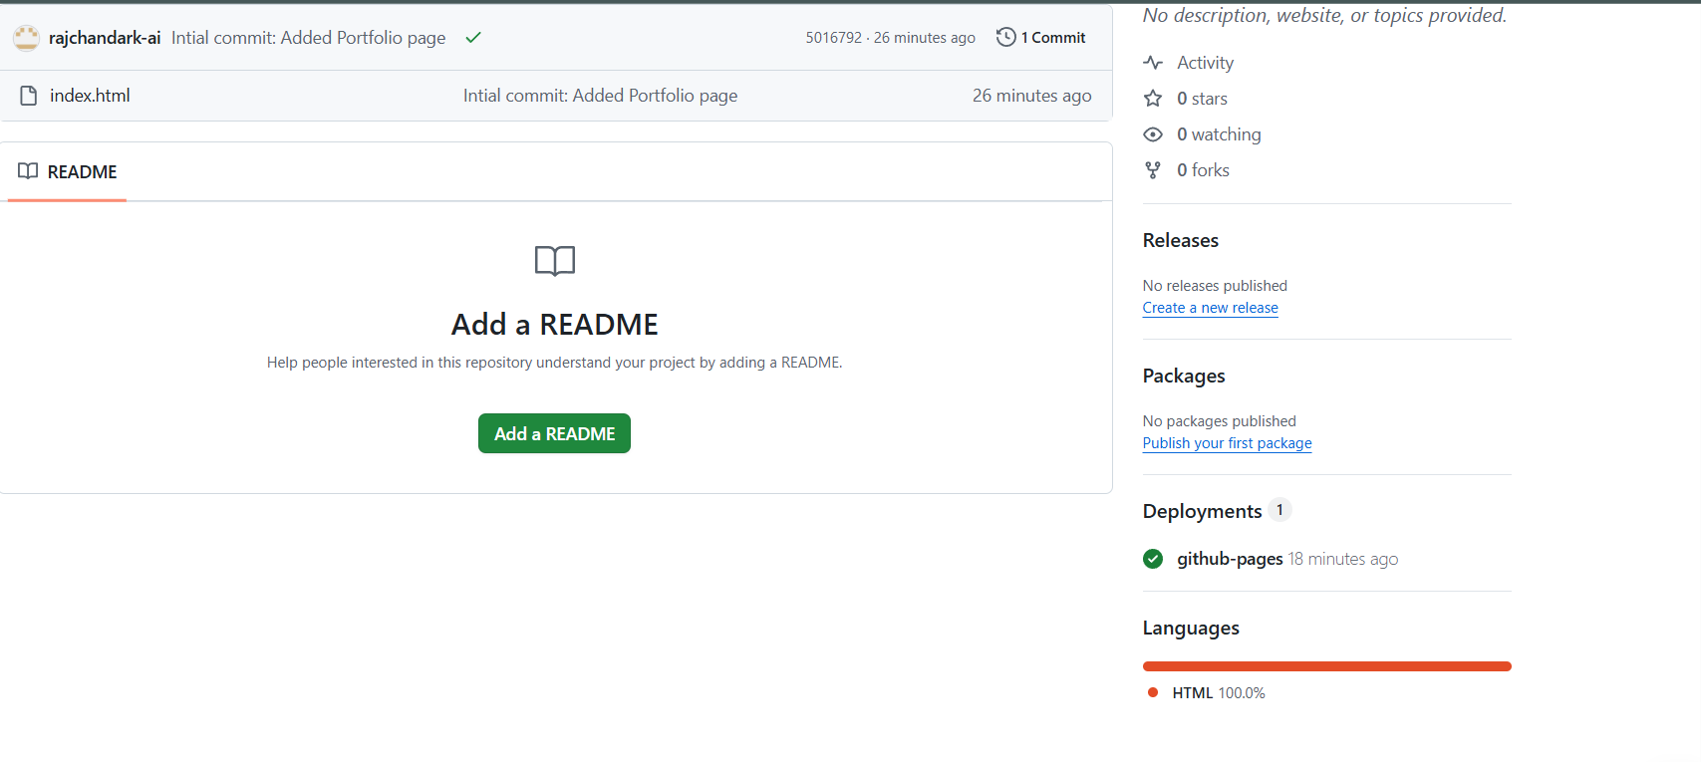
Your Repository Page with Deployment Link
Click Link Deployment

Slide 19
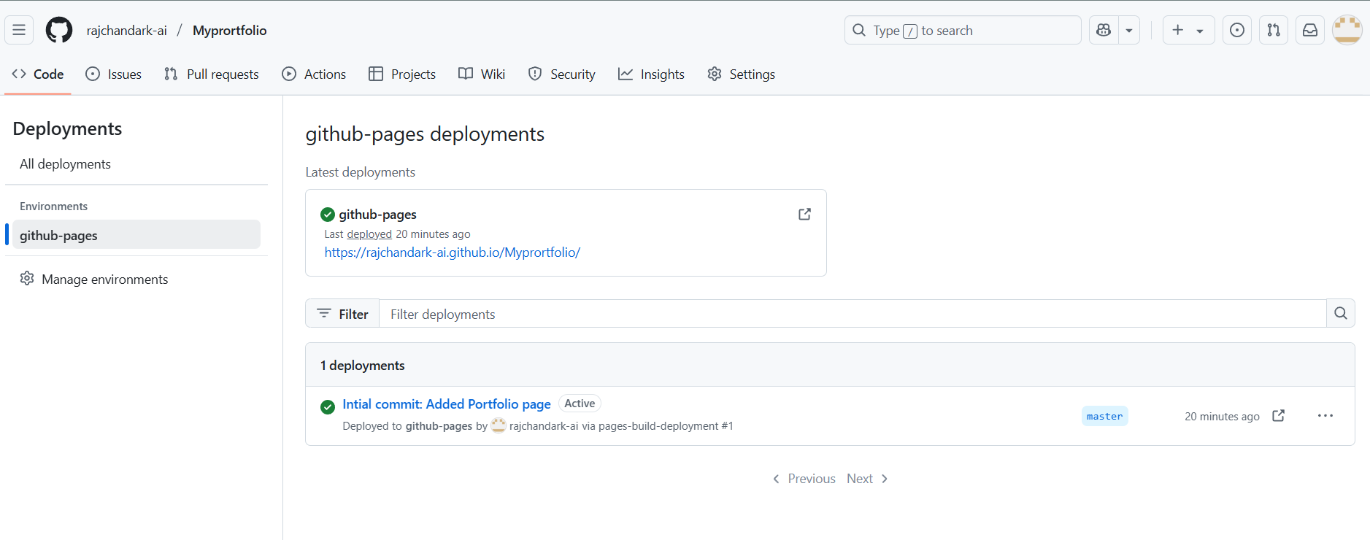
Web page Link
Click the Link in the Deployment page

Slide 20
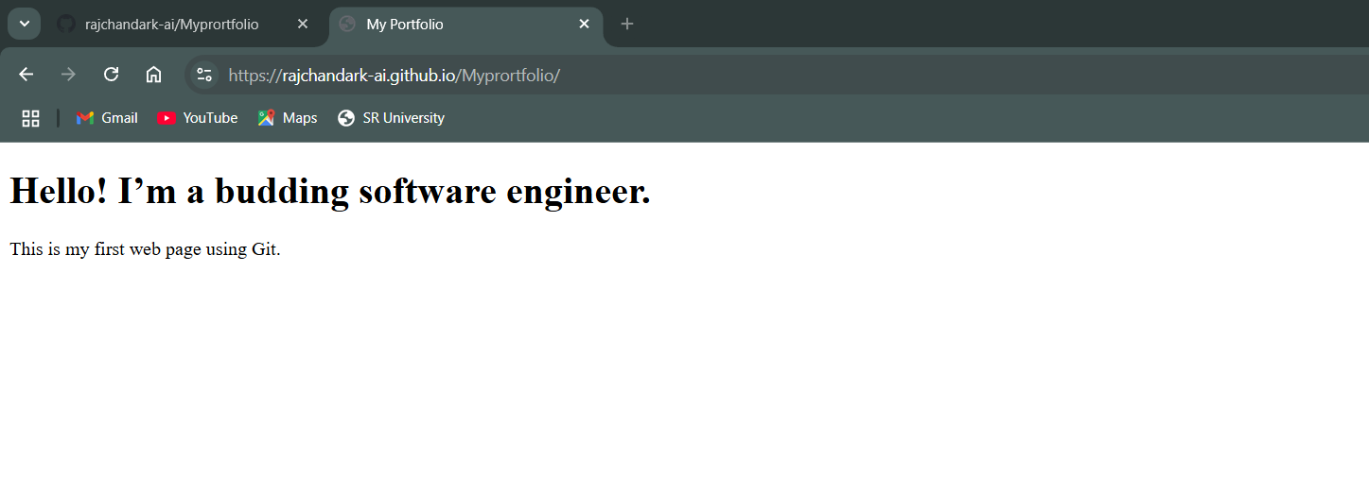
Website is Launched

Slide 21
Hands-on Activities (Step-by-Step)
Step | Activity | Git Command
1 | Initialize a Git Repository | git init
2 | Configure user details | git config --global user.name "Your Name" git config --global user.email "you@example.com"
3 | Create a file (e.g., hello.txt) and write content | Use VS Code or Notepad
4 | Add file to staging area | git add hello.txt
5 | Commit the file | git commit -m "Initial commit"
6 | Check status | git status
7 | View commit log | git log
8 | Modify file and commit again | Add a line → git add . → git commit -m "Updated file"
9 | Create GitHub repo and connect | git remote add origin https://github.com/user/repo.git
10 | Push to GitHub | git push -u origin master

